Slide 1
Hash Tables
Many applications require a dynamic set that supports only the dictionary operations
  INSERT, SEARCH, and DELETE
A hash table is effective for implementing a dictionary
The expected time to search for an element in a hash table is O(1), under some reasonable assumptions
Worst-case search time is Θ(n), however

Slide 2
Direct Addressing
Scenario:
  Maintain a dynamic set.
  Each element has a key drawn from a universe U = {0, 1, . . . ,m − 1} where m isn’t too large.
  No two elements have the same key.
Represent by a direct-address table, or array, T [0 . . .m − 1]

Slide 3
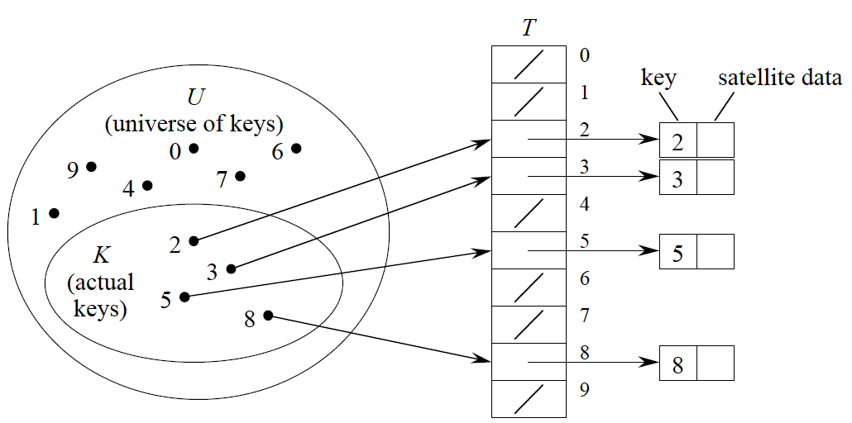
Direct-Address Table

Slide 4
Dictionary Operations
Dictionary operations are trivial and take O(1) time each:
  DIRECT-ADDRESS-SEARCH(T, k)
  return T [k]
  DIRECT-ADDRESS-INSERT(T, x)
  T [key[x]] ← x
  DIRECT-ADDRESS-DELETE(T, x)
  T [key[x]] ← NIL

Slide 5
Hash Tables
Problem with direct addressing:
  If the universe U is large, storing a table of size |U| may be impractical or impossible
Often, set of keys K is small compared to U
  most of the table is wasted
Solution:
  Use hash tables!
  When K is much smaller than U, a hash table requires much less space than a direct-address table.
  Can reduce storage requirements to Θ(|K|).
  Can still get O(1) search time, but in the average case, not the worst case.

Slide 6
What is a Hash Table?
Idea
  Instead of storing an element with key k in slot k, use a function h and store the element in slot h(k)
We call h a hash function.
  h : U → {0, 1, . . . ,m − 1}, so that h(k) is a legal slot number in T
  We say that k hashes to slot h(k)

Slide 7
Collisions
Collision:
  When two or more keys hash to the same slot
  Can happen when there are more possible keys than slots (|U| > m)
  For a given set K of keys with |K| ≤ m, may or may not happen. Definitely happens if |K| > m.
Must handle collisions in all cases
Use two methods:
  chaining
  open addressing

Slide 8
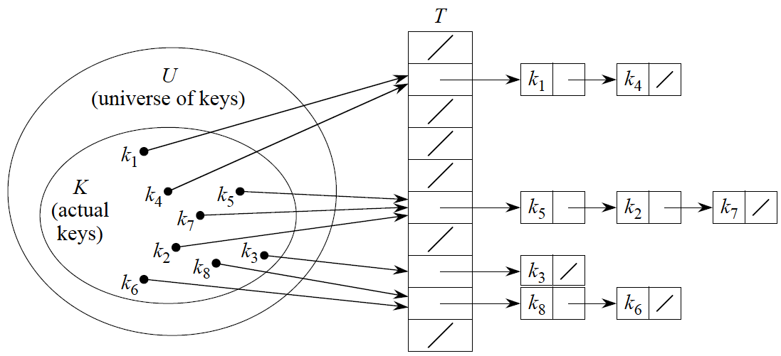
Collision Resolution by Chaining
Put all elements that hash to the same slot into a linked list

Slide 9
Dictionary Operations w/ Chaining
Insertion:
  CHAINED-HASH-INSERT(T, x)
  insert x at the head of list T [h(key[x])]
Worst-case running time is O(1)
Assumes that element being inserted isn’t already in the list
It would take an additional search to check if it was already inserted

Slide 10
Dictionary Operations w/ Chaining
Search:
  CHAINED-HASH-SEARCH(T, k)
  search for an element with key k in list T [h(k)]
Running time is proportional to the length of the list of elements in slot h(k)

Slide 11
Dictionary Operations w/ Chaining
Deletion:
  CHAINED-HASH-DELETE(T, x)
  delete x from the list T [h(key[x])]
Give pointer x to the element to delete, so no search is needed
Worst-case running time is O(1) time if the lists are doubly linked
If the lists are singly linked, then deletion takes as long as searching
  We must find x’s predecessor in its list in order to correctly update next pointers

Slide 12
Analysis of Hashing w/ Chaining
Most expensive operation is SEARCH
  n = # of input elements
  m = # of slots in hash table
Worst case
  O(n): All elements are in the same list
Average case
  n/m/2 = Θ(n/m)
  Depends on hash function. Hence we need good hash functions!

Slide 13
Hash Functions
What makes a good hash function?
  Ideally, the hash function distributes keys uniformly
  In practice, we don’t know the probability distribution that keys are drawn from, and the keys may not be drawn independently
  Use heuristics, based on the domain of the keys, to create a hash function that performs well

Slide 14
Keys as Natural Numbers
Hash functions assume that keys are natural numbers.
When they’re not, have to interpret them as natural numbers.
Example:
  Interpret a character string as an integer expressed in some radix notation. Suppose the string is CLRS:
  ASCII values: C = 67, L = 76, R = 82, S = 83.
  There are 128 basic ASCII values.
  So interpret CLRS as (67 · 128³)+ (76 · 128²)+ (82 · 128¹)+ (83 · 128⁰) = 141,764,947.

Slide 15
The Division Method
h(k) = k mod m
Example:
  m = 20 and k = 91⇒h(k) = 11
Advantage:
  Fast, since requires just one division operation
Disadvantage:
  Have to avoid certain values of m:
    Powers of 2 are bad. If m = 2^{p} for integer p, then h(k) is just the least significant p bits of k
  Good choice for m:
    A prime not too close to an exact power of 2

Slide 16
The Multiplication Method
  Choose constant A in the range 0 < A < 1.
  Multiply key k by A.
  Extract the fractional part of kA.
  Multiply the fractional part by m.
  Take the floor of the result.
That is, h(k) = floor(m (k A mod 1)), where
k A mod 1 = fractional part of kA.
Disadvantage:
  Slower than division method.
Advantage:
  Value of m is not critical.

Slide 17
Open Addressing
Store all keys in the hash table itself.
Each slot contains either a key or NIL.
To search for key k:
  Compute h(k) and examine slot h(k). Examining a slot is known as a probe.
  If slot h(k) contains key k, the search is successful. If this slot contains NIL, the search is unsuccessful.
  There’s a third possibility: slot h(k) contains a key that is not k. We compute the index of some other slot, based on k and on which probe (count from 0: 0th, 1st, 2nd, etc.) we’re on.
  Keep probing until we either find key k (successful search) or we find a slot holding NIL (unsuccessful search).

Slide 18
Pseudocode: Insert
HASH-INSERT(T, k)
i ← 0
repeat j ← h(k, i)
if T [ j ] = NIL
then T [ j ] ← k
return j
else i ← i + 1
until i = m
error “hash table overflow”

Slide 19
Pseudocode: Search
HASH-SEARCH(T, k)
i ← 0
repeat j ← h(k, i)
if T [ j ] = k
then return j
i ← i + 1
until T [ j ] = NIL or i = m
return NIL

Slide 20
Deletion
Problem:
  Cannot just put NIL into the slot containing the key we want to delete.
  It may break the sequence of probed elements, making some values inaccessible
Solution:
  Mark deleted elements with special key
New problem:
  Affects the running time of search
Ultimate solution:
  Use collision resolution by chaining

Slide 21
Computing Probe Sequences
Linear probing:
  Given auxiliary hash function h, the probe sequence starts at slot h(k) and continues sequentially through the table, wrapping after slot m − 1 to slot 0.
Problem:
  Primary clustering:
    Long runs of occupied sequences build up.

Slide 22
Computing Probe Sequences
Quadratic probing:
  Probe sequence starts at slot h(k)
  Jumps around in the table according to a quadratic function of the probe number: h(k, i ) = (h(k) + c₁i + c₂i ²) mod m, where c₁, c₂ are non-zero constants
Problem:
  Secondary clustering:
    Two distinct keys may have the same probe sequence

Slide 23
Computing Probe Sequences
Double hashing:
  Use two auxiliary hash functions, h₁ and h₂.
  h₁ gives the initial probe, and h₂ gives the remaining probes:
  h(k, i) = (h₁(k) + ih₂(k)) mod m.

